Slide 1
Emeritus ML Class
Lecture 17: Recommender Systems

Slide 2
Video 1: Introduction

Slide 3
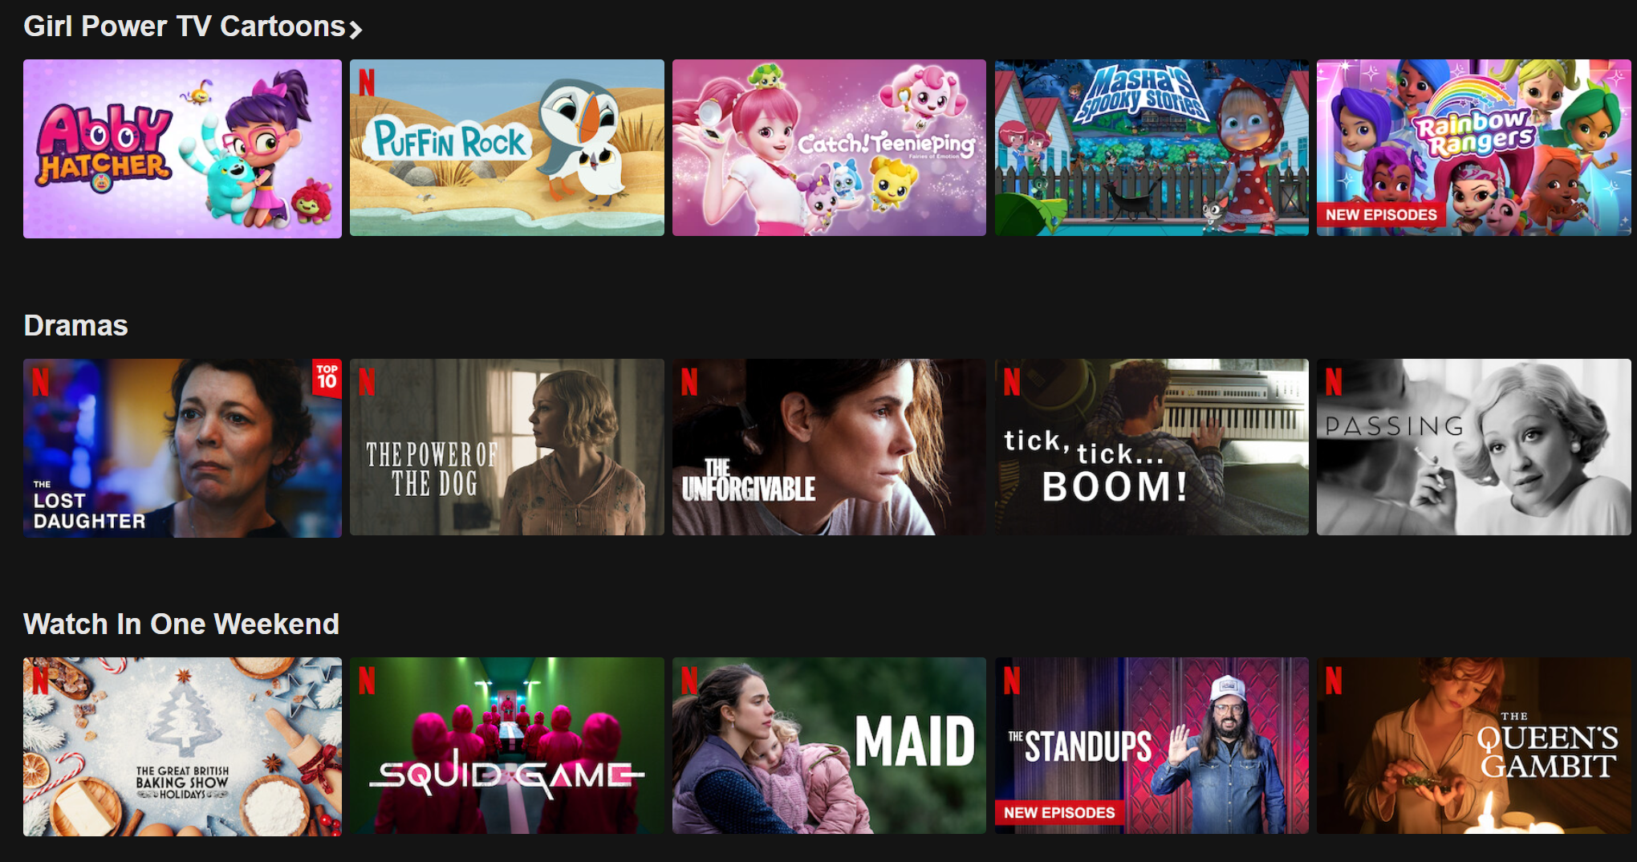
Notes:
Netflix is a video streaming service available in nearly every country around the world. In fact, as of the time of this video, it is available in every country in the world except China, North Korea, and Syria. With tens of thousands of movie and tv shows, there’s more than any individual person would ever watch.
When I log into Netflix, I’m presented with a screen similar to the one shown. Here, I’m given recommendations for shows to watch in several categories. In this case, one category is “Girl Power TV Cartoons”, with the most prominent rating being for something called “Abby Hatcher”. As I have a young daughter, this category is undoubtedly recommended to me because of her viewing. Interestingly, I don’t think my daughter has watched any of these specific shows.
The next category we see is Dramas, and again I’ve never seen any of these.
On the bottom row, we see “Watch in One Weekend”. Here we see two things that I have actually seen: The Great British Baking Show (which is great), and The Queen’s Gambit, which I’d also heartily endorse.
So how did Netflix decide to recommend these specific categories? And in these categories, how did it decide to recommend these shows and in this order? The decision was made by a recommender system, which knows about my previous viewing habits, including any ratings I explicitly gave to shows with the thumbs up / thumbs down buttons.

Slide 4

Notes:
Now consider what happens when I go to the online product marketplace Amazon. Here, we see a number of categories, each of which again contains a set of items, all in the hope of enticing me into making a purchase.
As someone who recently purchased a pack of batteries and a water boiler, I see that the algorithm is keen that I should acquire more of these, as well as a coffee grinder.
I have no idea why it’s offering me bedding, chairs, or Japanese products, but perhaps these are popular on the platform at the moment.
I did recently buy knives and whiteboard markers, and a month ago purchased an inflatable unicorn sled, so that explains the “inspired by your purchases” showing knives and some sort of large inflatable dinosaur.
Again, a recommender system is behind all of this – some model of me exists, and it wants me to buy these goodies.

Slide 5


Notes:
As a third and final example, consider the music streaming service Spotify. I do listen to quite a lot of music, especially when preparing lectures. Indeed, at the very moment I’m writing these words I’m listening to “Neu Chicago”, by “Clive Tanaka y su orquesta”, which, as it happens, automatically came on when my playlist by the artist “BrotherTiger” finished. Indeed, the recommender system that picked this song for me is so good that I thought BrotherTiger was still playing and was a bit surprised when I went to look at Spotify to write these words and saw it was this other artist I’d never heard of.
When I open Spotify, among the many recommendations it makes are daily mixes that exist for only one day. Here, we see four daily mixes, each in a different genre. The first is 70s/80s popular rock music artists. The second are a bunch of artists and mens choruses from the late 1950s early 1960s, for reasons I wont’ bore you with right now. The third mix is some excellent electronic music from the 2010s and alter anchored by the indomitable Paul Kalkbrenner, and the fourth mix appears to be a New Wave playlist of some sort, containing largely music from the 1980s.
All of these mixes were generated based on my recent music history, and I have to say, Spotify’s recommendation engine has been a truly amazing and enjoyable part of my music listening life, broadening my musical palette and introducing me to so much really great music from around the world (though that diversity is not reflected in these mixes).
Recommender systems are among the most absolutely important applications of AI/ML on the planet. Even very minor improvements to a recommender system uses by Amazon or Taobao can generate massive amounts of revenue. For many companies, recommender systems are their lifeblood. It is not unlikely that if you go into the field of AI/ML, you’ll find yourself working on a recommender system at some point. Today then, we will try to unmask these systems, and work towards understanding what makes them tick. Let our journey begin.

Slide 6
Video 2: Mathematical Framing

Slide 7





Framing Our Problem
Ommazh
Melt Banana
BTS
Zhou Shen
Sanam
An | 5 | 5 | 0 | 1 | 1
Bhavana | 4 | 5 | ? | 0 | 1
Cordelia | ? | 2 | 4 | 5 | 5
Diego | 2 | ? | 5 | ? | 4
Indie Lo-Fi
Highly Produced Pop
Notes:
Despite the incredible commercial importance of recommender systems, they do not lend themselves nearly so well to the sorts of nice and neat academic treatments that we’re used to in this course. Nor do they receive the level of research attention at major universities that you might expect. They’re big and messy and often more of an art than a science.
Today, I’ll focus primarily on one of the nice math problems that underlie the messiness of real recommender systems.
We’ll start by observing that one rather popular approach is to try to serve items that the user would rate highly. For example, the ecommerce platform Amazon might try to recommend products to me that I would rate a five out of five. Or Netflix, which uses a thumbs up thumbs down system, might try to recommend shows to me that I would thumbs up.
When recommending new items that I’ve never engaged with, e.g. a show I’ve never watched or a product I’ve never purchased, the platform does not know my ratings in advance. Thus, it must try to guess based on everything it knows about me.
To get a sense of what this problem looks like, consider the made up data shown. Here, we have four different users who have rated five albums by five different artists. The artists are Ommazh (a music group from Tatarstan), Melt Banana (from Japan), BTS (from Korea), Zhou Shen (from China), and Sanam (from India). We see that An gave Ommazh and Melt Banana the maximum rating of 5/5, but gave low ratings to BTS, Zhou Shen, and Sanam. Bhavana, who seems to have similar music tastes, rated Ommazh and Melt Banana highly as well, and rated Zhou Shen and Sanam low. Note that Bhavana has not rated BTS.
However, based on the data we have from An, we might imagine that Bhavana might also dislike BTS. That is the essence of what we’ll be trying to do with recommender systems.
We also see that we have two users Cordelia and Diego who look like they perhaps do not particularly care for Ommazh and Melt Banana, but who really like BTS, Zhou Shen, and Sanam. Of course we don’t know everything about Cordeila and Diego, but the narrative I’ve given here is consistent with the data that we do have available.
In the following videos, we’ll talk about different ways to try to fill in these question marks.

Slide 8
Video 3: Content Based Filtering

Slide 9
Framing Our Problem
Ommazh
Melt Banana
BTS
Zhou Shen
Sanam
An | 5 | 5 | 0 | 1 | 1
Bhavana | 4 | 5 | ? | 0 | 1
Cordelia | ? | 2 | 4 | 5 | 5
Diego | 2 | ? | 5 | ? | 4
Lo-Fi Indie
Slick Pop
Notes:
Knowing what I know about music, I’d say that BTS, Zhou Shen, and Sanam have something important in common: They are wildly successful and highly produced musical acts. By contrast, Ommazh and Melt Banana are independently produced lo-fi music.
In other words, the first two items would have a large value for some feature we might call the “Lo-fi Indie” feature, and the last three items would have a large value for some feature we might call the “Slick Pop” feature. Here “lo-fi” refers to music where imperfections are a deliberate aesthetic choice, and “indie” refers to the fact that the music is made independently of major record labels. By contrast, I’m using the word “slick” to represent music that is crafted to as near perfection as possible.
Of course there are many other possible features that an album could have, like “speed”, “latin influenced”, “vocal”, “chillwave”, “has pianos”, etc. In our running example, however, we’ll only use the two features that I personally came up.

Slide 10
Featurizing our Albums
Ommazh
Melt Banana
BTS
Zhou Shen
Sanam
An | 5 | 5 | 0 | 1 | 1
Bhavana | 4 | 5 | ? | 0 | 1
Cordelia | ? | 2 | 4 | 5 | 5
Diego | 2 | ? | 5 | ? | 4
Ommazh
Melt Banana
BTS
Zhou Shen
Sanam
Lo-Fi Indie | 0.8 | 0.95 | 0.05 | 0.02 | 0.2
Slick Pop | 0.1 | 0.01 | 0.99 | 0.95 | 0.9
Notes:
Suppose we had a panel of experts who sat down with each of these albums and assigned a rating from 0 to 1 for these two features. This might yield the numbers shown. We see that no album was given a score of 0 or 1 in any given category. We see also that these are not probabilities, i.e. they do not sum to 1. They are also not mutually exclusive, though in this case they appear to be opposed to each other. In some cases, your two factors may be almost entirely independent, e.g. imagine my two features were “female vocalist” and “in english”.
In the context of recommender systems, these features are often called “item factors”, i.e. they are factors that describe each items.
Given these features, we could simply train a linear regression model for each of our users on the data.

Slide 11
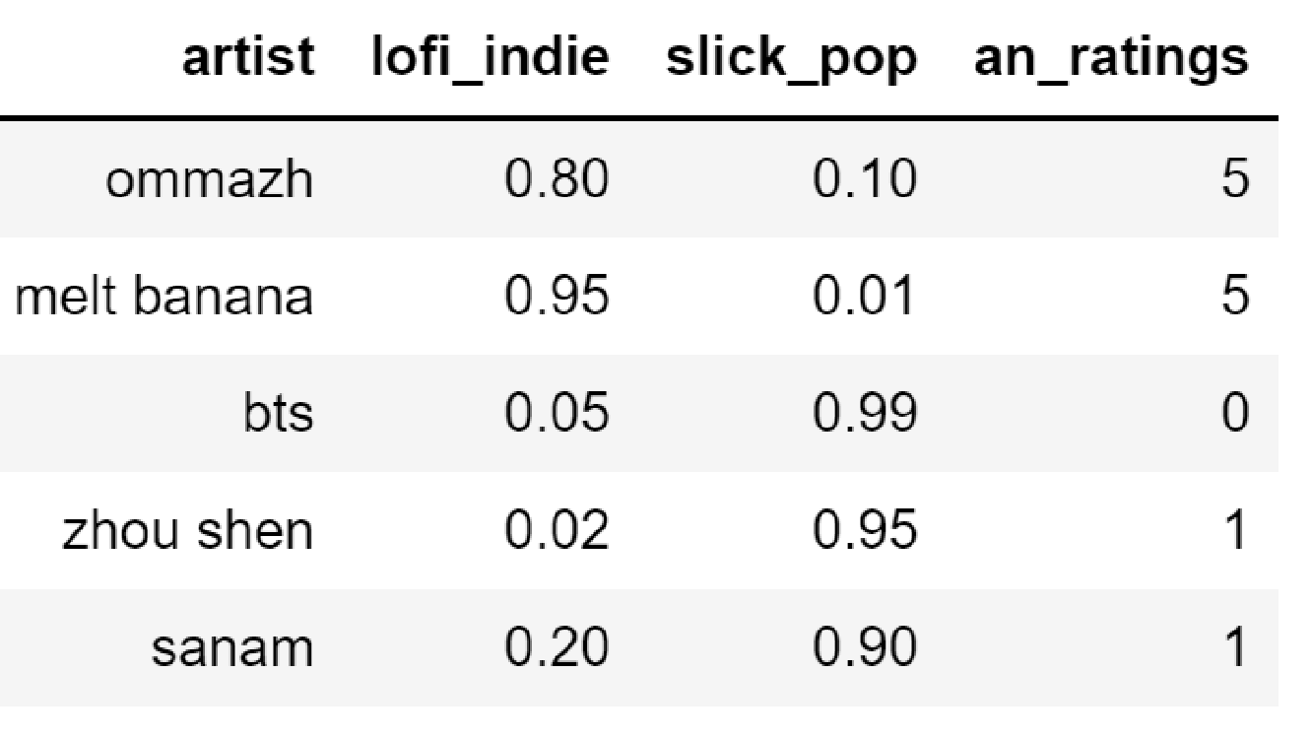
Fitting a Linear Regression Model
Ommazh
Melt Banana
BTS
Zhou Shen
Sanam
An | 5 | 5 | 0 | 1 | 1
Ommazh
Melt Banana
BTS
Zhou Shen
Sanam
Lo-Fi Indie | 0.8 | 0.95 | 0.05 | 0.02 | 0.2
Slick Pop | 0.1 | 0.01 | 0.99 | 0.95 | 0.9
Notes:
For example, consider the user An. We know that An has rated these albums 5, 5, 0, 1, and 1, respectively.
To fit a linear regression model, we can rearrange this data into a data frame as shown. We then fit a linear model predicting “an_ratings” from the “lofi_indie” an “slick_pop” columns.

Slide 12
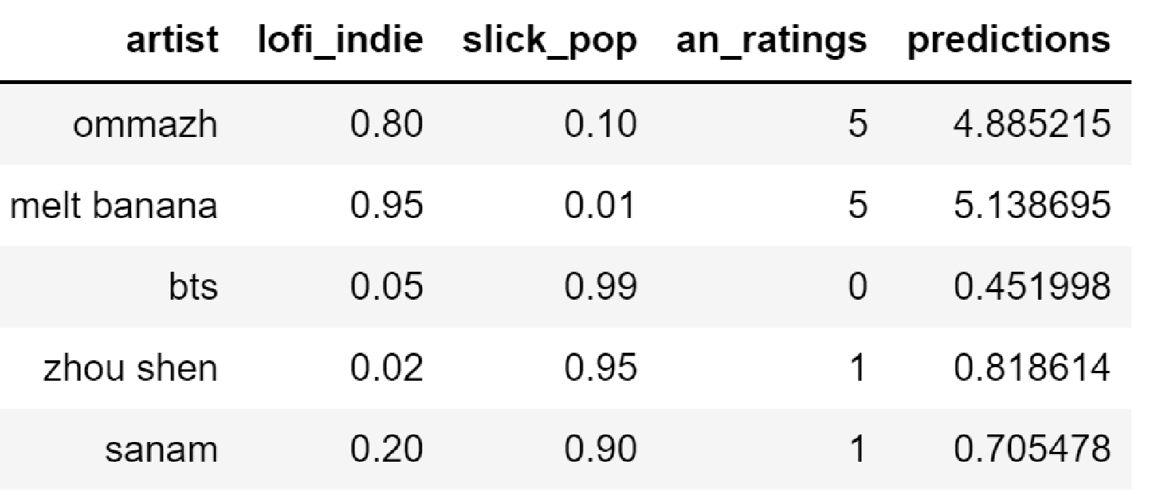
Fitting a Linear Regression Model
Notes:
Fitting this linear regression model, we get an intercept of 7.7, and theta_1 and theta_2 values of -2.63 and -7.20 respectively. Here, theta_1 indicates how much An enjoys lofi_indie, and theta_2 is how much An enjoys slick_pop.
In the context of recommender systems, these parameters are called the “user factors”.
The resulting predictions are as shown. Each prediction is computed in the normal way, i.e. it is the dot product of the parameters of the model with the features of the observation plus our bias term. Or in recommender system terminology, the prediction is the dot product of an’s user factors with the item’s factors. For example, ommazh’s user factors are 0.8 and 0.1, respectively. The dot product of these with an’s user factors of -2.63 and -7.2 yields -2.824. We then add an’s intercept of 7.7, yielding 4.88.
Since the true rating that An gave was 5, the squared error of this prediction is (5 – 4.88) squared. Note that the errors are nonzero – as with most linear regression problems, it’s impossible to get 100 percent accuracy with the given features.

Slide 13
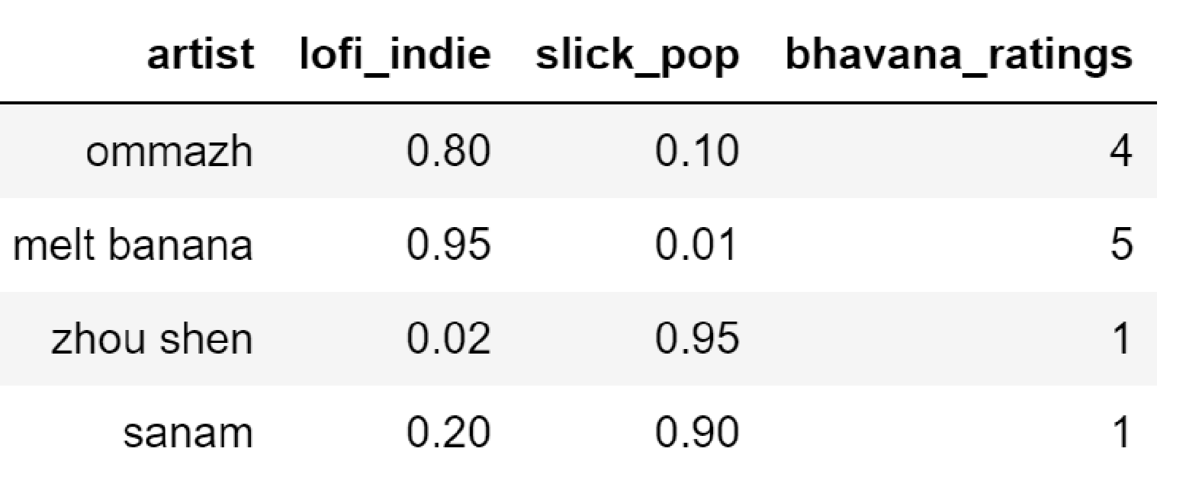
Predicting Unknown Ratings
Ommazh
Melt Banana
BTS
Zhou Shen
Sanam
Bhavana | 4 | 5 | ? | 0 | 1
Ommazh
Melt Banana
BTS
Zhou Shen
Sanam
Lo-Fi Indie | 0.8 | 0.95 | 0.05 | 0.02 | 0.2
Slick Pop | 0.1 | 0.01 | 0.99 | 0.95 | 0.9
Notes:
We can use this approach to predict a user’s rating of an album that they have not yet listened to.
For example, consider our user Bhavana. We do not have Bhavana’s rating for BTS. To fit a model, we could in principle create a dataframe like the one shown. Here we have only four rows because bhavana has not rated all five artists. Specifically, observe that bhavna’s ratingf for bts is missing from the dataframe.

Slide 14
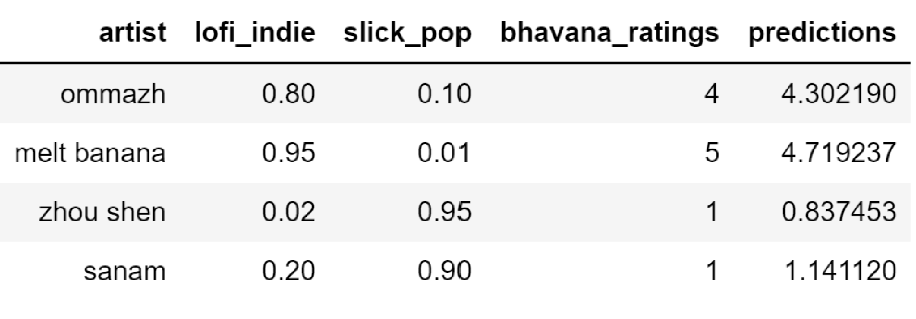
Predicting Unknown Ratings
Notes:
Fitting a linear regression model like before, this gives us an intercept for Bhavana of 4.05, and user factors of theta_1 and theta_2 of 0.74 and -3.4, respectively.
These parameters yield the predictions shown. Again, the predictions are not perfect.

Slide 15
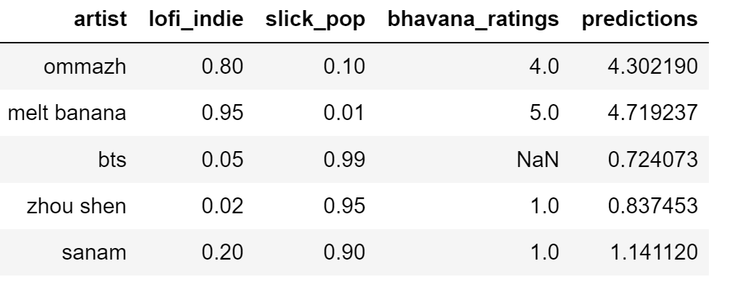
Predicting Unknown Ratings
Notes:
Now that we have our model, we can make a prediction for the bts album that Bhavana has never heard.
We know that bts has a lofi_indie value of 0.05, and a slick_pop value of 0.99, and we’ll use these values to guess at Bhavana’s rating for bts.
Specifically, the prediction for Bhavana’s rating of bts is the intercept 4.05 plus the dot product of the user factors and the item factors, i.e. 0.74 * 0.05 – 3.4 * 0.99. This yields a prediction of 0.724.

Slide 16
Filling in All Missing Ratings
Ommazh
Melt Banana
BTS
Zhou Shen
Sanam
An | 5 | 5 | 0 | 1 | 1
Bhavana | 4 | 5 | 0.724 | 0 | 1
Cordelia | 2.23 | 2 | 4 | 5 | 5
Diego | 2 | 1.00 | 5 | 5.46 | 4
Lo-Fi Indie
Slick Pop
Notes:
Repeating this process for Cordelia and Diego, we’d get the guessed prediction values shown. In our dataset, we only had 4 missing values, but in a real dataset, you’ll actually generally have a much much larger number of unknown ratings than known ones.
So now let’s think about how we might use this information in a “recommender system”. Suppose we want to offer a choice to Diego of a new album to listen to. Since Zhou Shen has a higher predicted rating of 5.46 vs a rating of 1.00 for Melt Banana, our system would do better to recommend Zhou Shen.
Note that our predicted ratings are sometimes outside of the scale, e.g. Zhou Shen is predicted to be a rating of 5.46 which exceeds the maximum rating of 5 – If you don’t like the idea that the predicted ratings can go outside th range, you can simply use min or max to constrain them. For example, we might replace the 5.46 given with a 5.
This approach I’ve described is known as “Content Based Filtering.” The word filtering is used because we are using the predicted ratings as a way to filter out or remove choices that we don’t want. For example, when spotify creates a mix for me, there are many millions of songs to choose from. Some sort of filtering algorithm removes all but a few dozen.
The words “content based” are used because the filtering is based on the content of the items – i.e. the item factors tell us whether the content is “slick pop” and/or “lo-fi indie”.
Note that in my example, the two categories were more or less mutually exclusive, but this is not usually the case. For example if we had “in English” as a feature, then Melt Banana, for example would have a score of a value of 0.95 for this feature.
Content based filtering works fine except for one big problem: In real world scenarios, we don’t typically have our items categorized into content categories. Somehow, we’d have to decide in advance what the categories should be, and then have some way of determining the values in each category. In the next set of videos, we’ll discuss an alternate approach.

Slide 17
Video 4: Collaborative Filtering

Slide 18
Alternate Problem Framing
Ommazh
Melt Banana
BTS
Zhou Shen
Sanam
An | 5 | 5 | 0 | 1 | 1
Bhavana | 4 | 5 | ? | 0 | 1
Cordelia | ? | 2 | 4 | 5 | 5
Diego | 2 | ? | 5 | ? | 4
 | lofi_indie | Slick_pop
An | 5 | 1
Bhavana | 4 | 0
Cordelia | 2 | 5
Diego | 2 | 4
Notes:
In the previous video, we saw content based filtering. In this approach, we start with an incomplete set of ratings , a complete set of item factors, and a totally unknown set of user factors. We then fit a linear regression model for each user. For each model, the parameters of the model are the inferred user factors, and the outputs of the model are our predictions for the missing ratings. The approach is simple and works beautifully, but requires us to somehow collect item factors for every item in our dataset.
As a thought experiment, let’s consider the opposite situation. Suppose we start with an incomplete set of ratings, a COMPLETE set of USER factors, and a TOTALLY UNKNOWN set of ITEM factors. In other words, rather than hiring experts to review each of our albums and assign item factors, we’ve instead surveyed our users and asked them how much they like lofi_indie and slick_pop in advance when they create their account so that we know the user factors.
Let’s suppose the survey yields the values shown, e.g. An loves lofi_indie music, rating it a 5/5, but only gives slick_pop a rating of 1/5.
If you think about it a bit, it turns out that we can build a linear regression model to predict ratings from our user factors. In this case, the predictions of our model will be the ratings as before, but the parameters of our model will be the inferred item factors.

Slide 19
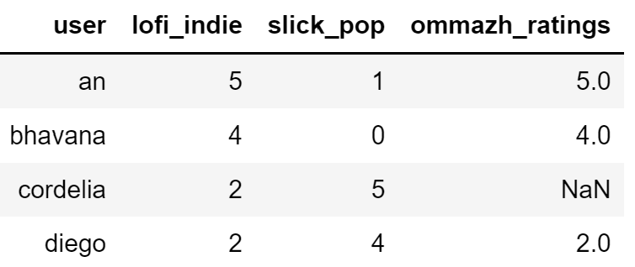
Alternate Problem Framing
Ommazh
Melt Banana
BTS
Zhou Shen
Sanam
An | 5 | 5 | 0 | 1 | 1
Bhavana | 4 | 5 | ? | 0 | 1
Cordelia | ? | 2 | 4 | 5 | 5
Diego | 2 | ? | 5 | ? | 4
 | lofi_indie | slick_pop
An | 5 | 1
Bhavana | 4 | 0
Cordelia | 2 | 5
Diego | 2 | 4
Notes:
For example, let’s start with our Ommazh album. We know An, Bhavana, and Diego’s ratings, but we don’t know Cordelia’s. Using everyone’s ratings of lofi_indie and slick_pop, we can try to predict Cordelia’s rating. One way to do this is to form the given dataframe shown.
We see that An has a “lofi_indie” preference of 5, and a “slick_pop” preference of 1, and rated ommazh as a 5.
Bhavana has a “lofi_indie” preference of 4, and a “slick_pop” preference of 0, and rated ommazh as a 4.
Lastly, we see that Diego has a “lofi_indie” preference of 2, and a “slick_pop” preference of 1, and rated ommazh as a 2.

Slide 20
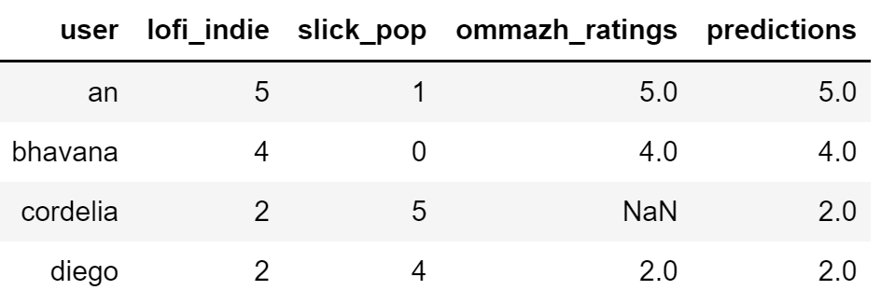
Computing Our Predictions
Ommazh
Melt Banana
BTS
Zhou Shen
Sanam
An | 5 | 5 | 0 | 1 | 1
Bhavana | 4 | 5 | ? | 0 | 1
Cordelia | 2.0 | 2 | 4 | 5 | 5
Diego | 2 | ? | 5 | ? | 4
 | lofi_indie | slick_pop
An | 5 | 1
Bhavana | 4 | 0
Cordelia | 2 | 5
Diego | 2 | 4
Notes:
If we fit a linear regression model on these 3 observations, we get back an ommazh prediction of 2.0 for Cordelia.

Slide 21
Interpreting Our Predictions
Ommazh
Melt Banana
BTS
Zhou Shen
Sanam
An | 5 | 5 | 0 | 1 | 1
Bhavana | 4 | 5 | ? | 0 | 1
Cordelia | 2.0 | 2 | 4 | 5 | 5
Diego | 2 | ? | 5 | ? | 4
 | lofi_indie | slick_pop
An | 5 | 1
Bhavana | 4 | 0
Cordelia | 2 | 5
Diego | 2 | 4
Notes:
As mentioned earlier, in this approach, the parameters of our model are the item factors which we infer.
For example, if we request the intercept and parameters for the ommazh model that we just fit, we get an intercept of 0, a theta_1 of 1, and a theta_2 of 0. That is the model considers ommazh to have a lofi_indie value of 1, and a slick_pop value of 0.

Slide 22
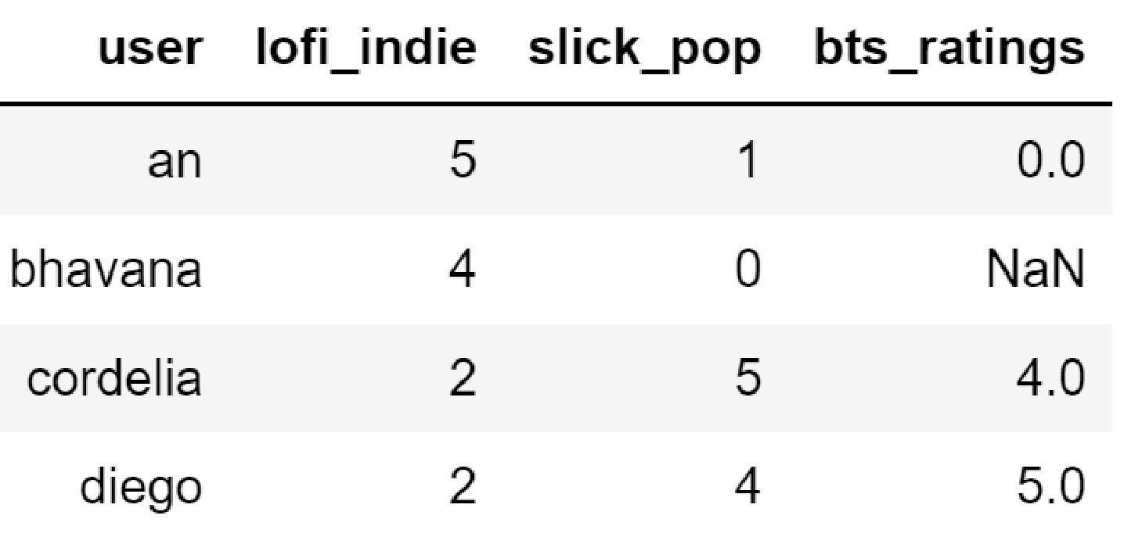
Estimating Bhavana’s Rating for BTS
Ommazh
Melt Banana
BTS
Zhou Shen
Sanam
An | 5 | 5 | 0 | 1 | 1
Bhavana | 4 | 5 | ? | 0 | 1
Cordelia | ? | 2 | 4 | 5 | 5
Diego | 2 | ? | 5 | ? | 4
 | lofi_indie | Slick_pop
An | 5 | 1
Bhavana | 4 | 0
Cordelia | 2 | 5
Diego | 2 | 4
Notes:
As another example, consider BTS. This time, we’d fit a model to the dataframe shown. Here we are using an’s, Cordelia’s and diego’s ratings of 0, 4, and 5, respectively.

Slide 23
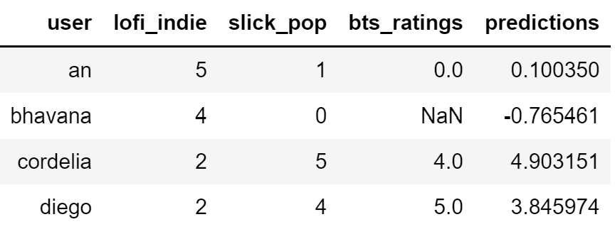
Estimating Bhavana’s Rating for BTS
Ommazh
Melt Banana
BTS
Zhou Shen
Sanam
An | 5 | 5 | 0 | 1 | 1
Bhavana | 4 | 5 | -0.77 | 0 | 1
Cordelia | 2.0 | 2 | 4 | 5 | 5
Diego | 2 | ? | 5 | ? | 4
 | lofi_indie | Slick_pop
An | 5 | 1
Bhavana | 4 | 0
Cordelia | 2 | 5
Diego | 2 | 4
Notes:
This linear regression model for BTS yields the given predictions. This time, the predictions have nonzero loss, e.g. it predicts an would give a rating of 0.1 to BTS, when An actually gave a zero.
Note that if we don’t like the fact that our model predicts that Bhavana would give a negative score to bts, we can simply replace this predicted score with a value of zero.

Slide 24
Interpreting Our BTS Model
Ommazh
Melt Banana
BTS
Zhou Shen
Sanam
An | 5 | 5 | 0 | 1 | 1
Bhavana | 4 | 5 | -0.77 | 0 | 1
Cordelia | 2.0 | 2 | 4 | 5 | 5
Diego | 2 | ? | 5 | ? | 4
 | lofi_indie | Slick_pop
An | 5 | 1
Bhavana | 4 | 0
Cordelia | 2 | 5
Diego | 2 | 4
Notes:
Let’s again interpret our model!
If we look at our parameters, we see that our intercept is 0, and our item factors theta_1 and theta_2 are -0.19 and 1.06, respectively.
We can think of these values as the degree to which bts belongs to our two categories. Here, our model has decided that bts is so NOT lofi_indie that the value is actually negative, and theta2 tells us that bts is very slick_pop.

Slide 25
Interpreting Our BTS Model
Ommazh
Melt Banana
BTS
Zhou Shen
Sanam
An | 5 | 5 | 0 | 1 | 1
Bhavana | 4 | 5 | -0.77 | 0 | 1
Cordelia | 2.0 | 2 | 4 | 5 | 5
Diego | 2 | ? | 5 | ? | 4
 | lofi_indie | Slick_pop
An | 5 | 1
Bhavana | 4 | 0
Cordelia | 2 | 5
Diego | 2 | 4
Notes:
This approach might also reasonably be called content filtering. The only difference is that rather than having to rate all of our items in advance under some common scale to create a set of known item factors, we instead have all of our users rate their preferences on some common scale to create a set of known user factors. In each case, we use linear regression to infer the factors that we don’t yet know.
Just like our first approach, generating the set of known factors is challenging.
This is because users don’t really like to sit down and rank all their preferences. Imagine signing up for a music streaming service and having to give ratings in dozens or hundreds of categories “How much do you like instrumental music?”, “How much do you like music with female singers?”, “How much do you like music in the Tatar language?”.

Slide 26
Collaborative Filtering
Ommazh
Melt Banana
BTS
Zhou Shen
Sanam
An | 5 | 5 | 0 | 1 | 1
Bhavana | 4 | 5 | -0.77 | 0 | 1
Cordelia | 2.0 | 2 | 4 | 5 | 5
Diego | 2 | ? | 5 | ? | 4
 | lofi_indie | Slick_pop
An | 5 | 1
Bhavana | 4 | 0
Cordelia | 2 | 5
Diego | 2 | 4
Notes:
This brings us to our next approach: Collaborative Filtering.
In this approach, we’ll start with ONLY the ratings. That is, we won’t have a known set of user factors or item factors.
Naturally, without these, we cannot do any sort of linear regression… Or can we?

Slide 27
Start: Choose Random Item Factors
Ommazh
Melt Banana
BTS
Zhou Shen
Sanam
An | 5 | 5 | 0 | 1 | 1
Bhavana | 4 | 5 | ? | 0 | 1
Cordelia | ? | 2 | 4 | 5 | 5
Diego | 2 | ? | 5 | ? | 4
Ommazh
Melt Banana
BTS
Zhou Shen
Sanam
F1 | 0.172 | 0.9 | -0.1 | 1.2 | 0.53
F2 | 0.96 | 0.91 | 0.6 | 0.71 | 0.21
Notes:
Here’s where we’ll get very clever. We’ll start by randomly making up some item factors. These will have absolutely no connection with reality and are just random numbers. There could be 1 item factor, 2 item factors, 50 item factors, whatever. These factors have no specific meaning at all. Here, I’ve chosen 2 for consistency with our earlier example. You should not think of these as “lofi_indie” or “slick_pop”, they are just some arbitrary feature. And the values are really entirely random values drawn from some distribution.

Slide 28
Compute Inferred User Factors
 | F1 | F2
An | -0.165 | 3.98
Bhavana | -1.72 | 5.20
Cordelia | 1.56 | 3.53
Diego | 3.59 | 3.76
Ommazh
Melt Banana
BTS
Zhou Shen
Sanam
F1 | 0.172 | 0.9 | -0.1 | 1.2 | 0.53
F2 | 0.96 | 0.91 | 0.6 | 0.71 | 0.21
Notes:
We’ll then fit a linear regression model for each user. For example, we’ll try to predict An’s ratings from the set of made up random item factors, yielding theta_1 = -0.165, and theta_2 = 3.98 These two parameters are our inferred factors about An. Note that for simplicity, I’ve set fit_intercept to false, i.e. every user’s intercept is zero.
What do these factors mean? They mean that An does not like music with factor 1, but does like music with factor 2.
Naturally, if we computed the error for our model, this model will have poor performance since the supposedly known item factors were just made up. As the old saying goes “Garbage in, garbage out”.

Slide 29
Compute New Inferred Item Factors
 | F1 | F2
An | -0.165 | 3.98
Bhavana | -1.72 | 5.20
Cordelia | 1.56 | 3.53
Diego | 3.59 | 3.76
Ommazh
Melt Banana
BTS
Zhou Shen
Sanam
F1 | -0.245 | … | … | … | …
F2 | 0.862 | … | … | … | …
Notes:
The clever part is what we do next: Using the user factors we just inferred from the randomly generated item factors, we’ll now fit linear regression models for EACH OF THE ITEMS, yielding a new set of item factors that are based on the user factors that are based on the randomly generated factors.
For example, our NEW item factors for Ommazh are -0.245 and 0.862. We’d then repeat for Melt Banana, BTS, Zhou Shen, and Sanam to get new item factors for each of those four albums.
If you’ve gotten a bit confused, make sure to consult the notebook provided for this lecture to see exactly how I generated these numbers.

Slide 30
Now Repeat
Random Item Factors
User Factors
Item Factors
User Factors
…
Ommazh
Melt Banana
BTS
Zhou Shen
Sanam
F1 | -1.53 | -1.77 | 1.16 | 1.09 | 0.73
F2 | 1.77 | 1.88 | 1.45 | 1.74 | 1.69
 | F1 | F2
An | -1.52 | 1.35
Bhavana | -1.51 | 1.11
Cordelia | 1.15 | 2.16
Diego | 1.19 | 2.15
Notes:
We then repeat the process, using these new item factors to create a new set of user factors. As we repeat this process over and over and over, we’ll see the squared error between our predicted ratings and the true ratings will continue to drop. The resulting model is often called a “collaborative filtering” model, the idea being that the users collaboratively gave us the data we needed to understand the users AND the items.
Nowt his may seem impossible at first glance. How can we start from a set of random item factors and get good results? The key is that during each iteration, we are using the incomplete ratings data to generate the next set of factors. And thus, at each iteration, our model is learning from the data. This is in fact no different from our usual ML models which start with some arbitrary starting parameters, and then use gradient descent to minimize loss.
What’s cool about this process is that we don’t even have to specify the meaning of the item factors in advance. Note that we do have to pick the number of factors to learn. Recall that I picked 2, but you could pick any number. In general, these factors are hard to interpret, i.e. once the process is done, you may not be able to learn anything at all about your data by looking at the values of the factors.
On the homework, you’ll get a chance to implement this algorithm and see how the error evolves with each step of the algorithm , as well as how the number of features affects performance.

Slide 31
Video 5: Gradient Descent View of Collaborative Filtering (the Funk SVD algorithm)

Slide 32


Gradient Descent
Ommazh
Melt Banana
BTS
Zhou Shen
Sanam
F1 | -1.53 | -1.77 | 1.16 | 1.09 | 0.73
F2 | 1.77 | 1.88 | 1.45 | 1.74 | 1.69
 | F1 | F2
An | -1.52 | 1.35
Bhavana | -1.51 | 1.11
Cordelia | 1.15 | 2.16
Diego | 1.19 | 2.15
Notes:
The collaborative filtering algorithm we described in the previous video works, but is inefficient. Each time we generate the next set of factors, we’re running an entire pass of gradient descent.
Rather than performing dozens, hundreds, or thousands of separate gradient descent steps, we can instead do a gradient descent that operates on user factors AND item factors at once.
To do this, we’ll need to write out a function to be minimized. And to do that, we’ll need some notation. Let’s start by defining our matrices P and Q. P represents our matrix of user factors, and has size M x Z, where M is the number of users, and Z is the number of factors.
We’ll also have our matrix Q which represents our matrix of item factors. It has size Z x N, where Z is the number of factors, and N is the number of items.
For our specific example, we have M = 4 users, and N = 5 albums. We also arbitrarily chose Z = 2 factors, though as noted earlier, this could have been any number we wanted.

Slide 33

Gradient Descent
Ommazh
Melt Banana
BTS
Zhou Shen
Sanam
F1 | -1.53 | -1.77 | 1.16 | 1.09 | 0.73
F2 | 1.77 | 1.88 | 1.45 | 1.74 | 1.69
 | F1 | F2
An | -1.52 | 1.35
Bhavana | -1.51 | 1.11
Cordelia | 1.15 | 2.16
Diego | 1.19 | 2.15
Notes:
Recall that prediction of our model for a given user for a given item is just the dot product of that user’s factor with that item’s factors. We can express this with the equation shown: r hat sub i comma j is equal to row EYE of P DOT column JAY of Q.

Slide 34


Gradient Descent
Ommazh
Melt Banana
BTS
Zhou Shen
Sanam
F1 | -1.53 | -1.77 | 1.16 | 1.09 | 0.73
F2 | 1.77 | 1.88 | 1.45 | 1.74 | 1.69
 | F1 | F2
An | -1.52 | 1.35
Bhavana | -1.51 | 1.11
Cordelia | 1.15 | 2.16
Diego | 1.19 | 2.15
Notes:
We can give the squared error of a prediction e sub eye comma jay squared as the difference between r hat sub eye comma ay and r sub eye comma jay, all squaed, where r sub eye comma jay is the true rating by user eye for item jay.

Slide 35
Gradient Descent
Cordelia’s true rating of Melt Banana: 2
Ommazh
Melt Banana
BTS
Zhou Shen
Sanam
F1 | -1.53 | -1.77 | 1.16 | 1.09 | 0.73
F2 | 1.77 | 1.88 | 1.45 | 1.74 | 1.69
 | F1 | F2
An | -1.52 | 1.35
Bhavana | -1.51 | 1.11
Cordelia | 1.15 | 2.16
Diego | 1.19 | 2.15
Notes:
To test your understanding, try computing e sub eye comma j squared for i = 3, j = 2, in other words, the error for this model’s prediction of Cordelia’s rating of melt banana. The true rating that cordelia gave was 2. Pause the video and use a calculator of some kind to compute a value.

Slide 36
Gradient Descent
Cordelia’s true rating of Melt Banana: 2
Ommazh
Melt Banana
BTS
Zhou Shen
Sanam
F1 | -1.53 | -1.77 | 1.16 | 1.09 | 0.73
F2 | 1.77 | 1.88 | 1.45 | 1.74 | 1.69
 | F1 | F2
An | -1.52 | 1.35
Bhavana | -1.51 | 1.11
Cordelia | 1.15 | 2.16
Diego | 1.19 | 2.15
Notes:
The first thing we need to do is compute the dot product of the 3rd row of PU with the 2nd row of QI. That dot product is 1.15 * -1.77 + 2.16 * 1.88 or 2.02.
Since the true value was 2, the squared error is (2.02 minus 2), all squared, yielding 0.0004.

Slide 37

Gradient Descent
Ommazh
Melt Banana
BTS
Zhou Shen
Sanam
F1 | -1.53 | -1.77 | 1.16 | 1.09 | 0.73
F2 | 1.77 | 1.88 | 1.45 | 1.74 | 1.69
 | F1 | F2
An | -1.52 | 1.35
Bhavana | -1.51 | 1.11
Cordelia | 1.15 | 2.16
Diego | 1.19 | 2.15
?!
Notes:
The MSE would be computed by simply repeating this process for all combinations of users and items, with one important caveat!
Consider ratings which do not exist in the dataset, for example, Diego has not rated Melt Banana. It would seem that e sub I comma j is undefined for i = 4, j = 2.
One approach would be to simply assign a true ratings value of r sub 4 comma 2 to zero, but this is a terrible idea. This will tell the algorithm a way to learn parameters such that all unseen items have a rating of zero, which is counterproductive.
Instead, we’ll modify our double summation slightly.

Slide 38

Gradient Descent
Ommazh
Melt Banana
BTS
Zhou Shen
Sanam
F1 | -1.53 | -1.77 | 1.16 | 1.09 | 0.73
F2 | 1.77 | 1.88 | 1.45 | 1.74 | 1.69
 | F1 | F2
An | -1.52 | 1.35
Bhavana | -1.51 | 1.11
Cordelia | 1.15 | 2.16
Diego | 1.19 | 2.15
Notes:
Specifically, instead of summing over all j, we’ll only sum over j in the set capital R sub I. The set R sub eye is all the items which user i has rated. For example R_4 I s the set {1, 3, 5}, since Diego has rated artists 1, 3, and 5.
Note that I’ve left the N on top of the sum over j. This is just meant as a mnemonic reminder that the j values can go between 1 and N, i.e. that we’re iterating over the columns of Q. This is nonstandard use of the sum notation, and a more formal mathematical treatment would omit this N.

Slide 39
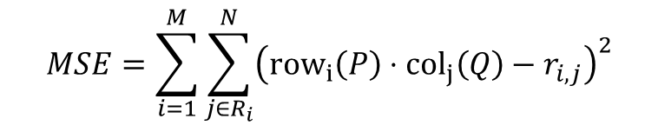
Gradient Descent
Ommazh
Melt Banana
BTS
Zhou Shen
Sanam
F1 | -1.53 | -1.77 | 1.16 | 1.09 | 0.73
F2 | 1.77 | 1.88 | 1.45 | 1.74 | 1.69
 | F1 | F2
An | -1.52 | 1.35
Bhavana | -1.51 | 1.11
Cordelia | 1.15 | 2.16
Diego | 1.19 | 2.15
Notes:
Expanding this out, we have the MSE is the sum over i = 1 to M of the sum over j = 1 to N of the square of (the ith row of P dot the jth column of Q minus r sub eye comma jay).
Take a moment to pause the video and really reflect on what this expression is saying: The MSE will be the sum of all of the dot products minus the corresponding true value.

Slide 40
Gradient Descent
Ommazh
Melt Banana
BTS
Zhou Shen
Sanam
F1 | -1.53 | -1.77 | 1.16 | 1.09 | 0.73
F2 | 1.77 | 1.88 | 1.45 | 1.74 | 1.69
 | F1 | F2
An | -1.52 | 1.35
Bhavana | -1.51 | 1.11
Cordelia | 1.15 | 2.16
Diego | 1.19 | 2.15
Notes:
To test your understanding: How many terms will there be in the MSE expression for the example from this lecture. In other words, how many dot products will we need to compute to compute the MSE?

Slide 41
Gradient Descent
Ommazh
Melt Banana
BTS
Zhou Shen
Sanam
F1 | -1.53 | -1.77 | 1.16 | 1.09 | 0.73
F2 | 1.77 | 1.88 | 1.45 | 1.74 | 1.69
 | F1 | F2
An | -1.52 | 1.35
Bhavana | -1.51 | 1.11
Cordelia | 1.15 | 2.16
Diego | 1.19 | 2.15
Notes:
In total, there will be 16! While there are 20 total possible dot products, only 16 will be computed. The other 4 correspond to ratings that don’t exist in the original dataset, and thus will not be included in the MSE. The first of these squared errors will be the 0.0004 value we computed in our earlier example, followed by 15 more.

Slide 42




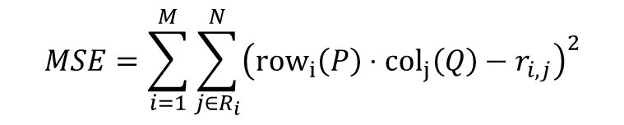


















Gradient Descent
Ommazh
Melt Banana
BTS
Zhou Shen
Sanam
F1 | -1.53 | -1.77 | 1.16 | 1.09 | 0.73
F2 | 1.77 | 1.88 | 1.45 | 1.74 | 1.69
 | F1 | F2
An | -1.52 | 1.35
Bhavana | -1.51 | 1.11
Cordelia | 1.15 | 2.16
Diego | 1.19 | 2.15
Notes:
This brings us to our goal! We want to pick values for 𝑃 and 𝑄 such that the MSE is minimized.
Here, we’ll need to introduce a bit more notation. Let P sub eye comma j be the value of ith row and jth column of P. And likewise with Q.
We thus have a total of 8 P parameters: P 1 comma 1, P 1 comma 2, P 2 comma 1, P 2 comma 2, P 3 comma 1, P 3 comma 2, and P 4 comma 1, and P 4 comma 2 and a total of 10 Q parameters: Q 1 comma 1, Q 1 comma 2, Q 1 comma 3, Q 1 comma 4, Q 1 comma 5, Q 2 comma 1, Q 2 comma 2, Q 2 comma 3, Q 2 comma 4, and Q 2 comma 5.
In all then, our gradient descent will be optimizing the MSE over an 18 dimensional space, corresponding to these 18 matrix values.

Slide 43




The Gradient Descent Rule
Ommazh
Melt Banana
BTS
Zhou Shen
Sanam
F1 | -1.53 | -1.77 | 1.16 | 1.09 | 0.73
F2 | 1.77 | 1.88 | 1.45 | 1.74 | 1.69
 | F1 | F2
An | -1.52 | 1.35
Bhavana | -1.51 | 1.11
Cordelia | 1.15 | 2.16
Diego | 1.19 | 2.15
Notes:
From these equations, we can derive the gradient descent update rule for our algorithm. Specifically, you can show that at each gradient descent step, we want to update user factor P sub a comma b so that it is equal to the old P sub a comma b times minus the learning rate alpha times the sum of all the errors for user a, e sub a comma j times, with each error weighted by the corresponding item factor Q sub b comma j.
This equation relies on the fact that the partial derivative of the squared error e sub i comma j is equal to 2 times e sub a comma j times Q sub comma j. The proof is somewhat involved and tedious if you really want to understand it, so I won’t cover I there.
We can also derive a similar rule for Q, not shown here.
If you wanted, you could also regularize your model by including a regularization term. In that case, the update rules will be slightly different.

Slide 44
The Gradient Descent Rule
Ommazh
Melt Banana
BTS
Zhou Shen
Sanam
F1 | -1.53 | -1.77 | 1.16 | 1.09 | 0.73
F2 | 1.77 | 1.88 | 1.45 | 1.74 | 1.69
 | F1 | F2
An | -1.52 | 1.35
Bhavana | -1.51 | 1.11
Cordelia | 1.15 | 2.16
Diego | 1.19 | 2.15
Notes:
To make sure we understand what the update rule means, let’s pick a specific P that we’d like to update. Let’s pick P 4 comma 1 arbitrarily.
The update rule therefore tells us Diego’s first factor should be updated as follows: We take our old value of 1.19, and subtract alpha times the error for the prediction for An’s rating of Ommazh scaled by the first factor of Ommazh plus the error of the prediction of An’s rating of BTS times the first factor of BTS plus the error of An’s rating of Sanam times the first factor of Sanam.

Slide 45
The Gradient Descent Rule
Ommazh
Melt Banana
BTS
Zhou Shen
Sanam
F1 | -1.53 | -1.77 | 1.16 | 1.09 | 0.73
F2 | 1.77 | 1.88 | 1.45 | 1.74 | 1.69
 | F1 | F2
An | -1.52 | 1.35
Bhavana | -1.51 | 1.11
Cordelia | 1.15 | 2.16
Diego | 1.19 | 2.15
Notes:
We have these Q values readily available (they are the first item factor for each of our three albums), so can expand out those out easily as shown.

Slide 46
The Gradient Descent Rule
Ommazh
Melt Banana
BTS
Zhou Shen
Sanam
F1 | -1.53 | -1.77 | 1.16 | 1.09 | 0.73
F2 | 1.77 | 1.88 | 1.45 | 1.74 | 1.69
Rating: 2 Rating: 5 Rating: 4
 | F1 | F2
An | -1.52 | 1.35
Bhavana | -1.51 | 1.11
Cordelia | 1.15 | 2.16
Diego | 1.19 | 2.15
Notes:
That still leaves e sub 4 comma 1, e sub 4 comma 3, and 3 sub 4 comma 5.
To test your understanding, try to find the value of this expression if alpha is 0.1. You’ll need to know the true ratings that Diego gave to Ommazh, BTS, and Sanam. These were 2, 5, and 4 respectively.

Slide 47
The Gradient Descent Rule
Ommazh
Melt Banana
BTS
Zhou Shen
Sanam
F1 | -1.53 | -1.77 | 1.16 | 1.09 | 0.73
F2 | 1.77 | 1.88 | 1.45 | 1.74 | 1.69
Rating: 2 Rating: 5 Rating: 4
 | F1 | F2
An | -1.52 | 1.35
Bhavana | -1.51 | 1.11
Cordelia | 1.15 | 2.16
Diego | 1.19 | 2.15
Notes:
To compute e sub 4 comma 1, we simply compute the dot product of Diego’s factors with Ommazh’s factors, then subtract off the true rating. This gives us a value of approximately 1.98 – 2 or -0.02.

Slide 48
The Gradient Descent Rule
Ommazh
Melt Banana
BTS
Zhou Shen
Sanam
F1 | -1.53 | -1.77 | 1.16 | 1.09 | 0.73
F2 | 1.77 | 1.88 | 1.45 | 1.74 | 1.69
Rating: 2 Rating: 5 Rating: 4
 | F1 | F2
An | -1.52 | 1.35
Bhavana | -1.51 | 1.11
Cordelia | 1.15 | 2.16
Diego | 1.19 | 2.15
Notes:
To compute e sub 4 comma 3, we simply compute the dot product of Diego’s factors with BTS’s factors, then subtract off the true rating. This gives us a value of approximately 4.5 – 5 or -0.5.

Slide 49
The Gradient Descent Rule
Ommazh
Melt Banana
BTS
Zhou Shen
Sanam
F1 | -1.53 | -1.77 | 1.16 | 1.09 | 0.73
F2 | 1.77 | 1.88 | 1.45 | 1.74 | 1.69
Rating: 2 Rating: 5 Rating: 4
 | F1 | F2
An | -1.52 | 1.35
Bhavana | -1.51 | 1.11
Cordelia | 1.15 | 2.16
Diego | 1.19 | 2.15
Notes:
To compute e sub 4 comma 5, we simply compute the dot product of Diego’s factors with Sanam’s factors, then subtract off the true rating. This also gives us a value of approximately 4.5 – 5 or -0.5.

Slide 50
The Gradient Descent Rule
Ommazh
Melt Banana
BTS
Zhou Shen
Sanam
F1 | -1.53 | -1.77 | 1.16 | 1.09 | 0.73
F2 | 1.77 | 1.88 | 1.45 | 1.74 | 1.69
Rating: 2 Rating: 5 Rating: 4
 | F1 | F2
An | -1.52 | 1.35
Bhavana | -1.51 | 1.11
Cordelia | 1.15 | 2.16
Diego | 1.19 | 2.15
Notes:
Multiplying out the weighted errors, we get that the new value of P 4,1 should be 1.19 plus 0.0914 or 1.28. That’s assuming I didn’t mess up the algebra somewhere.
To complete an entire gradient descent pass, we’d do this exact same thing for the other 17 of our parameters. Note that I have not given the expression for the update rule for Q. Nor will I go through the proof for the expression for P. This proof is not difficult, it’s just long.
After finishing a grading descent pass, we’d then repeat this process again and again and again until our error is low enough that we’re happy.
The ultimate result of this whole procedure is that we will convert our original matrix of ratings R into two matrices P and Q, where P represents our inferred user factors, and Q represents our inferred item factors.
The name of this algorithm is called “Funk SVD”, for reasons I’ll describe a bit more shortly.
Note that in our example here, I used a choice of Z = 2 factors. However, in general, you can make Z into whatever you want.
In the next video, we’ll reflect a bit more carefully on what this whole procedure means from a linear algebra perspective.

Slide 51
Video 6: Alternate View: Matrix Factorization

Slide 52
Ommazh
Melt Banana
BTS
Zhou Shen
Sanam
F1 | -1.53 | -1.77 | 1.16 | 1.09 | 0.73
F2 | 1.77 | 1.88 | 1.45 | 1.74 | 1.69
 | F1 | F2
An | -1.52 | 1.35
Bhavana | -1.51 | 1.11
Cordelia | 1.15 | 2.16
Diego | 1.19 | 2.15
Notes:
Before we get started with this video, let’s do a quick review exercise to check your understanding. Consider the item and user factors computed from earlier.
Suppose we wanted to compute An’s rating for Ommazh, what would it be?

Slide 53
Ommazh
Melt Banana
BTS
Zhou Shen
Sanam
F1 | -1.53 | -1.77 | 1.16 | 1.09 | 0.73
F2 | 1.77 | 1.88 | 1.45 | 1.74 | 1.69
 | F1 | F2
An | -1.52 | 1.35
Bhavana | -1.51 | 1.11
Cordelia | 1.15 | 2.16
Diego | 1.19 | 2.15
Notes:
Based on these values, it would be the dot product of the Ommazh column with the An row, yielding -1.53*-1.52 + 1.77*1.35 or 4.72.

Slide 54
Ommazh
Melt Banana
BTS
Zhou Shen
Sanam
F1 | -1.53 | -1.77 | 1.16 | 1.09 | 0.73
F2 | 1.77 | 1.88 | 1.45 | 1.74 | 1.69
 | F1 | F2
An | -1.52 | 1.35
Bhavana | -1.51 | 1.11
Cordelia | 1.15 | 2.16
Diego | 1.19 | 2.15
Notes:
Generalizing from this review exercise, we observe a very important relationship between our hidden ratings, the user factors, and the item factors. Specifically, if we represent our predicted ratings by the matrix R tilde, the user factors by the matrix P, and the item factors by the matrix Q, we have that R tilde is the matrix product of P and Q.

Slide 55
Some sort of graphic
Notes:
Factoring a matrix into two matrices does not yield a unique solution. In fact, there’s not even a unique size for the two matrices.
For the example from before, P_U was 4x2, and Q_I was 2x5. But if we had picked 50 factors, they would have been 4x50 and 50x5 respectively.
The specific factorization we derived came from performing a gradient descent which found values for our 4x2 P_U and 2x5 Q_I such that the MSE was minimized. As I mentioned in the previous video, this algorithm is often called “Funk SVD” or even just “SVD” for short. However, it is NOT the same thing as singular value decomposition, despite the fact that it has the same name.
This technique was originally used to great success in the Netflix challenge in 2006 by an author named Simon Funk. At that time, Netflix offered a million dollar prize for the team that had the best performance on their ratings dataset, with the caveat that they had to exceed Netflix’s own algorithm by at least 10%. Interestingly, in 2009 in the 3rd year of the contest, there were two teams that passed the 10% threshold and exactly tied, both earning a root mean squared error of 0.8567. However, one team submitted their solution 20 minutes earlier, earning them the million dollar prize.
Simon Funk was a pseudonym for researcher Brandyn Webb. In December 2006, in the early months of the contest, he wrote a blog post describing the algorithm we’ve used today. In this description, he claims that his factorization is equivalent to singular value decomposition and called it SVD for short. However, it is not singular value decomposition.
We can tell it is not SVD for a couple of reasons. First, SVD decomposes an MxN matrix into 3 matrices of sizes MxM, MxN, and NxN, respectively, whereas Funk SVD allows us to arbitrarily decompose into two matrices of size MxZ and ZxN, where Z is any size of our choosing. Secondly, the matrices that SVD have a property called orthogonality, which Funk SVD matrices do not.
Despite the fact that this gradient descent based matrix factorization technique is not actually singular value decomposition, it is still frequently called SVD because it was misidentified as such by the author who popularized the technique.
There are other matrix factorization techniques out there, such as SVD++. We won’t discuss this in lecture, but you’ll have a chance to try it out on the homework.

Slide 56
Why Not Use SVD?
Ommazh
Melt Banana
BTS
Zhou Shen
Sanam
An | 5 | 5 | 0 | 1 | 1
Bhavana | 4 | 5 | ? | 0 | 1
Cordelia | ? | 2 | 4 | 5 | 5
Diego | 2 | ? | 5 | ? | 4
Notes:
This does raise the interesting question: Why not just use REAL SVD for matrix decomposition instead of this new technique from a 2006 blog post that involves gradient descent and seems complicated.
The reason is simple: SVD doesn’t have any way to deal with missing entries.
If you happened to have a matrix of ratings with no missing entries, using SVD would indeed be a reasonable way to extract user and item factors. But for our problem where we likely have a huge number of missing entries, an alternate matrix factorization technique is needed.

Slide 57
Video 7: The SURPRISE Library

Slide 58
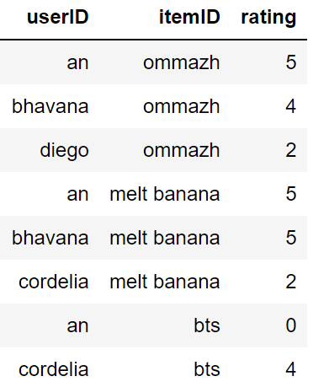
The SURPRISE Library
Ommazh
Melt Banana
BTS
Zhou Shen
Sanam
An | 5 | 5 | 0 | 1 | 1
Bhavana | 4 | 5 | ? | 0 | 1
Cordelia | ? | 2 | 4 | 5 | 5
Diego | 2 | ? | 5 | ? | 4
…
Notes:
As of the time of this video, scikit learn does not support the Funk SVD algorithm or other common ratings prediction algorithms, nor does it significantly support recommender systems.
However, there is a library created by Nicolas Hug (no relation to me) called SURPRISE. SURPRISE lets you design and analyze recommender systems.
It has a lot in common conceptually with sklearn, though there are some significant API differences. In this video, I’ll walk through a simple example of the SURPRISE library so that you’re prepared for the homework. I won’t go into a great amount of detail because the documentation for SURPRISE is quite good.
Before we get to using SURPRISE, let’s start by looking at a pandas dataframe that we’ll use as our dataset. Here I’m only showing the first so many rows.
Note that this dataframe is simply the matrix for ratings from before, only now it’s given as a list of ratings rather than a grid of values.

Slide 59
The SURPRISE Library
from surprise import Dataset
from surprise import Reader
reader = Reader(rating_scale=(0, 5))
sf = Dataset.load_from_df(df[['userID', 'itemID', 'rating']],
reader)
…
Notes:
SURPRISE doesn’t know how to work with DataFrames natively, so before we can use this dataframe in SURPRISE, we need to convert it into what SURPRISE calls a “DatasetAutoFolds ” object.
We start by creating a Surprise “Reader” object and specifying the ratings scale, in this case between 0 and 5. We then use the Dataset module’s load_from_df function as shown.
The resulting sf object is now almost ready for use.

Slide 60
The SURPRISE Library
from surprise import Dataset
from surprise import Reader
reader = Reader(rating_scale=(0, 5))
sf = Dataset.load_from_df(df[['userID', 'itemID', 'rating']],
reader)
training_data = sf.build_full_trainset()
…
Notes:
Before it can be fed to an algorithm like Funk SVD, we have to create a training set from the DatasetAutoFolds object that we just generated.
In a context where we want to avoid overfitting, we’d create a separate training and test set. However, since we’re just trying to demonstrate how to use the library, we’ll just use the entire data set as our training set. To do this, we’ll use the line of code shown, where we call the “build_full_trainset” function of our DatasetAutoFolds object.
You’ll learn how to do a proper train/test split on the homework.

Slide 61
The SURPRISE Library
from surprise import Dataset
from surprise import Reader
reader = Reader(rating_scale=(0, 5))
sf = Dataset.load_from_df(df[['userID', 'itemID', 'rating']],
reader)
training_data = sf.build_full_trainset()
import surprise
model = surprise.SVD(n_factors = 2,
n_epochs = 10000,
biased = False)
model.fit(training_data)
…
Notes:
Now that we have our training set, we can train our algorithm. The syntax is somewhat similar to sklearn. First, we create a model, in this case a surprise.SVD object. Here, I’ve set n_factors to 2, meaning that our SVD will come up with 2 hidden factors, just like in our running example. You can pick any number here, though, for example we could have picked 50. on the homework you’ll explore how Funk SVD models behave as a function of the number of factors. I’ve also said n_epochs = 10000. The termination conditions for the SURPRISE implementation of Funk SVD are unclear to me, and leaving the model at its default value of 20 yields poor results for only 2 factors. Finally, I’ve set the biased argument to False, which is similar to the fit_intercept = False parameter in sklearn.
Then we call fit. Note that unlike linear regression, logistic regression, etc. there is no separate x or y. We simply provide the Trainset object. This is because SURPRISE Dataset objects already have everything annotated in a form that SURPRISE’s models know how to read.
Once we’ve done this, the model has been fit. In this case, surprise.SVD implements the Funk SVD algorithm from before. Recall that this is not the same thing as singular value decomposition, despite the name.

Slide 62
The SURPRISE Library
from surprise import Dataset
from surprise import Reader
reader = Reader(rating_scale=(0, 5))
sf = Dataset.load_from_df(df[['userID', 'itemID', 'rating']],
reader)
training_data = sf.build_full_trainset()
import surprise
model = surprise.SVD(n_factors = 2,
n_epochs = 10000,
biased = False)
model.fit(training_data)
…
model.predict("an", "ommazh")
Notes:
Similar to sklearn models, we can now use the predict method to make predictions. For example, if we call model.predict("an", "ommazh"), we’ll get back 4.83, which is fairly close to the true rating of 5. We can also compute predictions like model.predict(“cordelia", "ommazh"), yielding a prediction of 5. That is, even though Cordelia has not rated Ommazh, the algorithm believes that she would rate Ommazh a 5.

Slide 63
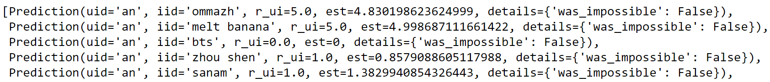
The SURPRISE Library
training_data = sf.build_full_trainset()
import surprise
model = surprise.SVD(n_factors = 2,
n_epochs = 10000,
biased = False)
model.fit(training_data)
test_data = training_data.build_testset()
predictions_list = model.test(test_data)
…
Notes:
The predict method in SURPRISE only generates a single prediction a time. This is unlike sklearn where you can provide an entire dataset at once.
If we instead want to know the overall error of our model on a dataset, we must first generate a test set. In our case, we want to evaluate the error on the full set of data, so we simply call the build_testset method on our TrainSet object.
Our next step is to generate a list of predictions, which we can do by calling model.test on the test set. Note that this function does NOT work on object of type TrainSet.
The first few entries in the list of predictions generated are shown. Note that each prediction includes both the true value and the predicted value.

Slide 64
The SURPRISE Library
training_data = sf.build_full_trainset()
import surprise
model = surprise.SVD(n_factors = 2,
n_epochs = 10000,
biased = False)
model.fit(training_data)
test_data = training_data.build_testset()
predictions_list = model.test(test_data)
…
Notes:
To compute the MSE on these predictions, we can call the surprise.accuracy.mse function on the predictions_list.
Note that unlike sklearn, the mse function did not require us to specify a separate “prediction” and “expected” argument. This is because each prediction contains both. Philosophically, the SURPRISE library’s API likes to package things up into annotated objects, rather than leaving them relatively naked like sklearn.
In this case, we get that the resulting value is 0.0235.
If we were to try again with more factors, we’d get a lower MSE, but we’d start to run the risk of overfitting. To avoid overfitting we’d need to do the usual workflow where we train on a training set, but then use a validation set to decide which hyperparameter to pick. In this case, our hyperparameter is the number of factors. You’ll get a chance to try this out on the homework.
SURPRISE also supports kfold cross validation and even its own GridSearchCV.
As one of our goals in this class is to give you practice with learning to read documentation and explore new libraries on your own, I will not be explaining how GridSearchCV works. Instead, you’ll be expected to read the SURPRISE documentation to figure out how it works, though support will be provided of course, if you get stuck on the homework.

Slide 65
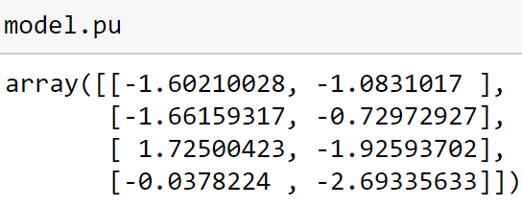
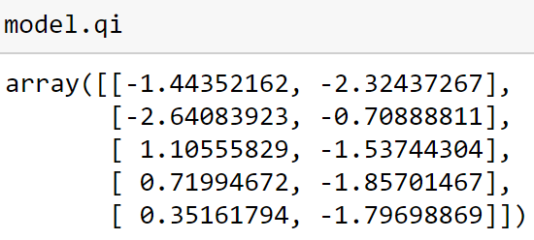
Looking at Our Model Parameters
training_data = sf.build_full_trainset()
import surprise
model = surprise.SVD(n_factors = 2,
n_epochs = 10000,
biased = False)
model.fit(training_data)
Notes:
Naturally, we can also access our model’s parameters. To get our user factors, we call model.pu, and to get our item factors, we call model.qi. These are our P and Q matrices from before, though our Q was actually the transpose of what SURPRSIE calls qi.
For example, when I ran the code, I got the model.pu and model.qi shown. Since Funk SVD is based on gradient descent which starts from a random starting point, you will get different values, possibly dramatically so, if you try running my code.
To interpret these tables, consider the top left entry of pu: -1.60. This is how much our first user (an) enjoys music with the first factor (which has no specific meaning). The value next to it is how much an enjoys music with the second factor. Both are negative, but the first factors is more negative. We might say then that An prefers music with the second factor over music which contains the first factor.
Similarly, consider the top left entry of qi of -1.44. This is how much our first artist (Ommazh) has the first factor. It’s negative, implying that Ommazh is the opposite of whatever the first factor means. The second factor is even more negative, at a value of -2.32.
By contrast, consider the row starting with 1.1 in qi. This represents bts. It has a large positive value for this factor. Thus, I might interpret the first factor as the “pop” factor. Ommazh and melt banana are negative because they are the opposite of pop music. By contrast, bts, zhou shen, and Sanam are all pop music to varying degrees. I have no idea how I might interpret the second factor.

Slide 66
Looking at Our Model Parameters
training_data = sf.build_full_trainset()
import surprise
model = surprise.SVD(n_factors = 2,
n_epochs = 10000,
biased = False)
model.fit(training_data)
Notes:
To generate a prediction, we simply compute the dot product of the appropriate factors. For example if we take the dot product of the first entry in model.pu with the first entry in model.qi, we’re computing the rating for an for Ommazh. In this case, we’d get -1.60 times -1.44 – 1.08 times -2.32, yielding the value of around 4.8 that we saw before. In other words, since an doesn’t like pop music or whatever the second factor is, and since Ommazh is the opposite of both of those factors, then an actually really likes Ommazh.

Slide 67
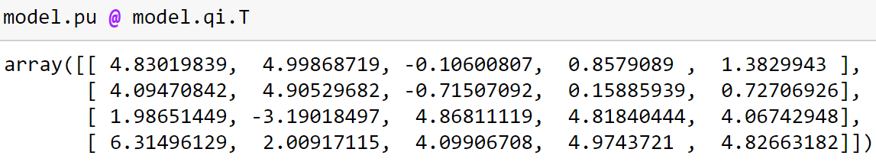
Looking at Our Model Parameters
training_data = sf.build_full_trainset()
import surprise
model = surprise.SVD(n_factors = 2,
n_epochs = 10000,
biased = False)
model.fit(training_data)
Notes:
More generally, we can form all of our predictions by computing the matrix product of pu with the transpose of qi.

Slide 68
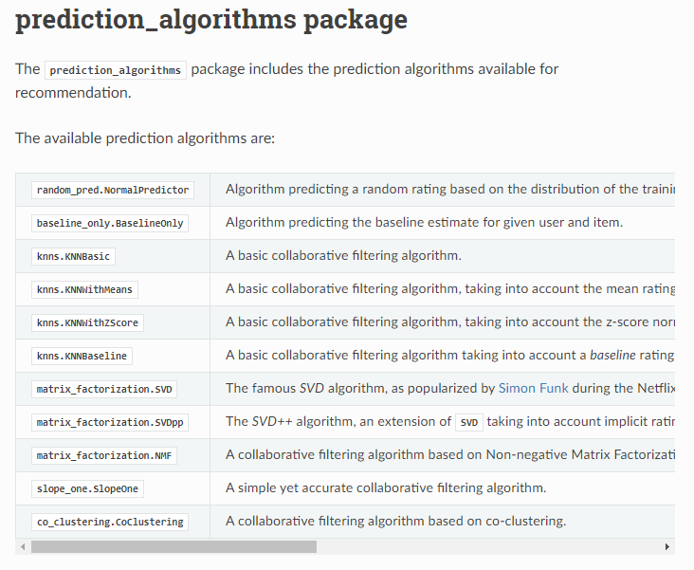
Other Prediction Algorithms
Notes:
One last note: The SURPRISE library also supports many other techniques for CollaborativeFiltering other than the Funk SVD algorithm I described in lecture. For example, it also contains another matrix factorization approach called SVD++, which was inspired by the FunkSVD algorithm.
However, it also supports non-matrix factorization based techniques. For example, pme natural approach is to simply use a natural implementation of the k nearest neighbors technique, which SURPRISE supports in the predictions_algorithm package.

Slide 69
Video 8: Hybrid Recommender Systems

Slide 70
Ommazh
Melt Banana
BTS
Zhou Shen
Sanam
An | 5 | 5 | 0 | 1 | 1
Bhavana | 4 | 5 | 0.724 | 0 | 1
Cordelia | 2.23 | 2 | 4 | 5 | 5
Diego | 2 | 1.00 | 5 | 5.46 | 4
Notes:
We’ve talked a great deal about mathematical techniques we can use to predict unknown ratings. And we’ve seen how we can use the SURPRISE library to generate them in a user friendly way.
But the obvious question is: After we compute all these ratings, how do we decide what to recommend to our users?
One obvious choice is to simply create a list of the highest rated items and recommend those.

Slide 71
Metrics for Recommendation
Recommender systems might recommend items that are:
Predicted to have high ratings.
Similar (or dissimilar!) to previously viewed or rated items.
Promoted by advertisers.
Newly added to the service.
Previously viewed items.
Items that are popular on the service.
Common regular purchases that the user will need soon.
Notes:
However, there are other possibilities. For example, the Spotify music streaming service actually creates many different lists of recommendations for its users. As we saw earlier, it created daily mixes. Each mix consists of a set of items that are similar to each other, and which Spotify thinks I would enjoy.
In other words, Spotify is considering not just the rating, but the similarity of items.
We can also imagine Spotify or other services trying to create playlists or suggestions that are explicitly dissimilar to my previously rated items, but which it anticipates I would rate highly. This would encourage me as a user to explore new things, which might make me appreciate the service more.
That raises the interesting question of how you rate the similarity of items, but we’ll get back to that in a moment.
There are also many other metrics we might use for deciding what to recommend. For example, we might boost the profile of items that advertisers have paid us to promote. Or we might give more weight to items that have been newly added to the service. We might simply recommend items that users have already engaged with (e.g. music on Spotify). And we might just recommend things that are popular across the platform as a whole. There are even more niche possibilities like recommending products that we think the users is likely to buy at the moment based on recurring user behavior -- for example because the user buys toothpaste every 2 months, and its been 2 months since the last purchase.
Items that use a combination of these metrics are called “hybrid recommender systems”, and in practice, essentially every real world recommender system is a hybrid system. That is, rather than focusing only on ratings, they will also focus on one or more of these other metrics.

Slide 72
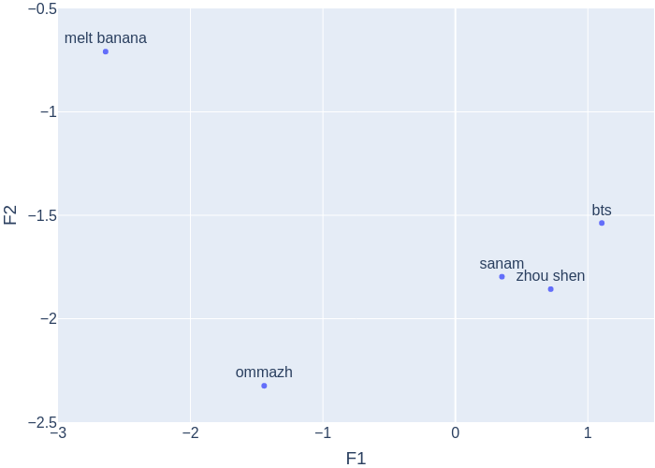
Item Similarity
Ommazh
Melt Banana
BTS
Zhou Shen
Sanam
F1 | -1.44 | -2.64 | 1.11 | 0.72 | 0.35
F2 | -2.32 | -0.71 | -1.54 | -1.86 | -1.80
Notes:
Now with regards to the similarity question: How do we know how similar two items are?
It turns out that the inferred item factors that we compute are perfect for this. Each item is a point in a Z dimensional space. For example, consider the item factors matrix we had from before which shows the 2 factor values for our 5 different albums. Here, Z = 2.
To compute the similarity, we simply compute the distance between two points. For example, the distance between Ommazh in the top row and melt banana in the row below is the square root of (-1.44 + 2.64)^2 + (-2.32 + 0.7)^2.

Slide 73
Video 9: Conclusion

Slide 74
Conclusion 1 (no text)
Notes:
Recommender systems, also known as recommendation systems, have one job: They recommend items to users.
As input, they take knowledge about users, items, and interactions between users and items.
It is very common in recommender systems to have access to ratings data.
Ratings could be star ratings from 0 to 5, or could be a simpler scale such as like/dislike.
Recommender systems that use ratings try to predict ratings for items that users has not yet rated.
We discussed two approaches for predicting unseen user ratings.
First we saw content based filtering, which relies on having a known set of item factors or user factors. Note that the definition of content based filtering is a bit slippery, and other sources may use this term in a different sense than I have today.
Second, we saw collaborative filtering, where the algorithm infers user and item factors from a set of ratings data.
We can implement collaborative filtering using iterated passes of linear regression, alternately generating user factors, then item factors, then user factors, and so forth.
Or we can implement collaborative filtering using the Funk SVD algorithm, which isn’t actually singular value decomposition.
We saw that the Funk SVD algorithm is a form of matrix factorization, taking an original matrix of ratings and decomposing it into the product of two matrices, one of user factors, and another of item factors.
We saw how Nicolas Hug’s SURPRISE library can be used to build and evaluate ratings models, and you’ll explore this library in more detail on the homework.

Slide 75
Conclusion 2 (no text)
Notes:
Though we focused a lot on ratings, they are only one facet of the broader problem of recommender systems. While recommending highly rated items to users is obviously a powerful tool, often other metrics are used for determining which items to recommend, such as similarity to other items, frequently viewed items and more.
Trying to decide which metrics to focus on when building a recommender system is an art, not a science. Unlike tasks such as classification, regression, or rating prediction, there’s no mathematically defined loss function.
Instead, each company or other entity that builds a recommender system must employ some guesswork, engaging in user studies, evaluating downstream metrics like revenue, satisfaction, or engagement, and employing techniques like A/B testing. All of these are well outside of the scope of our course.
If you ever end up working to build such recommender systems, you’ll find that you have to learn a totally unique toolchain and a set of techniques for evaluating the quality of your recommendation. However, this module provides you with the foundation you’ll need if you ever need to work on a recommender system, or simply wanted to know how they work.
Thanks for watching, and I’ll see you next time!

